Slide 1





Customer Segmentation
TravelTide
Erick Strampfer Monje

Slide 2


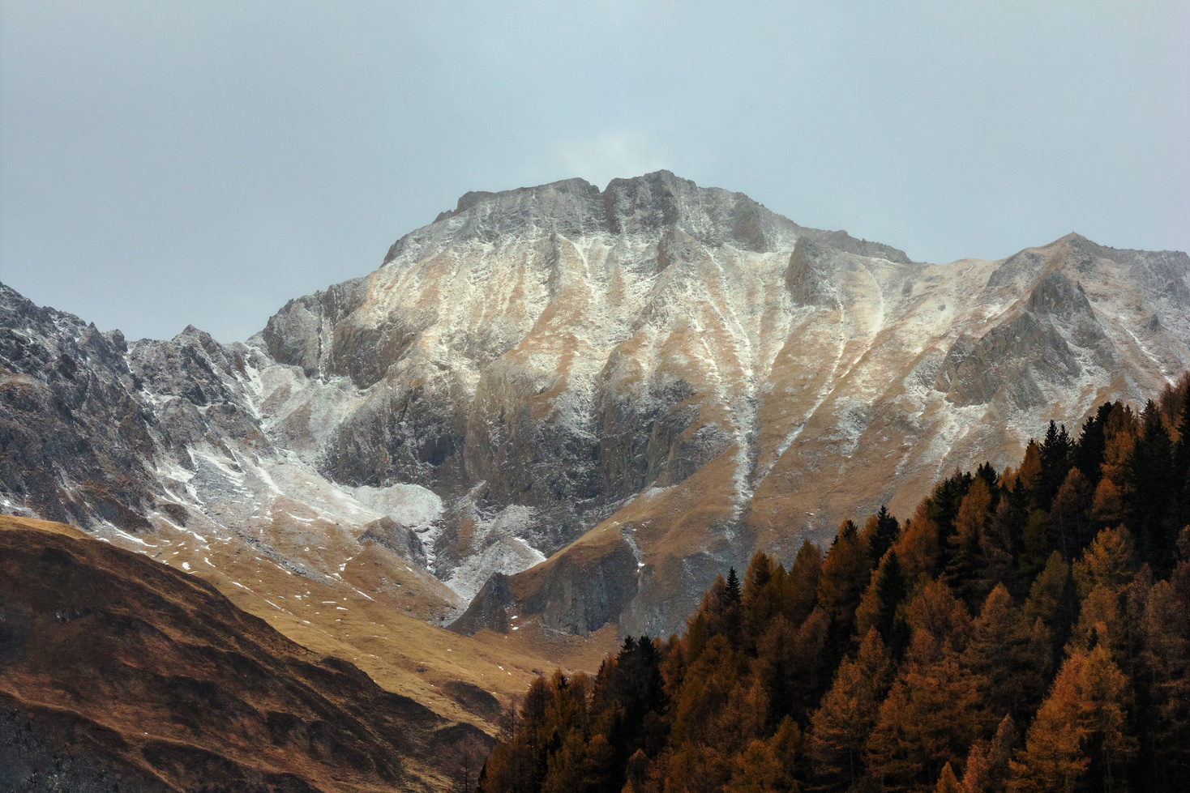
Table of Contents
Grasping Customer Profiles Across Different Segments
📌 Adult Explorer
📌 Family Traveler
📌 Business Traveler
📌 Young Traveler
📌 Hotel Only
📌 Visitor with High Potential
📌 Just Looking
Summary & Next Steps
Who We Are
Project Goals
The Journey from Data to Perks
Where our Users Reside
Cohort & Facts
Decision Tree

Slide 3

TravelTide
Who We Are
E-Booking Startup in the Online Travel Industry
Since its inception in April 2021, the company has experienced consistent growth within the online travel sector.
TravelTide offers its customers access to the most extensive travel inventory available in the e-booking market!

Slide 4

Collect and analyze data to understand our customers and their travel habits.
Project Goals
Categorize customers according to their behavior
Provide perks that motivate customers from each segment to return and engage with the experience again.

Slide 5

The Journey from Data to Perks
Cohort Selection & EDA
By integrating different tools, we refined the data to ensure we have the optimal raw material for the next step.
Segmentation
We categorize users based on various metrics, including sums, averages, demographics, and finding patterns in common.
Rewarding Program – Perks
Once we have a clear understanding of our clients' profiles, we decided to assign various perks to acknowledge and reward their preferences.

Slide 6
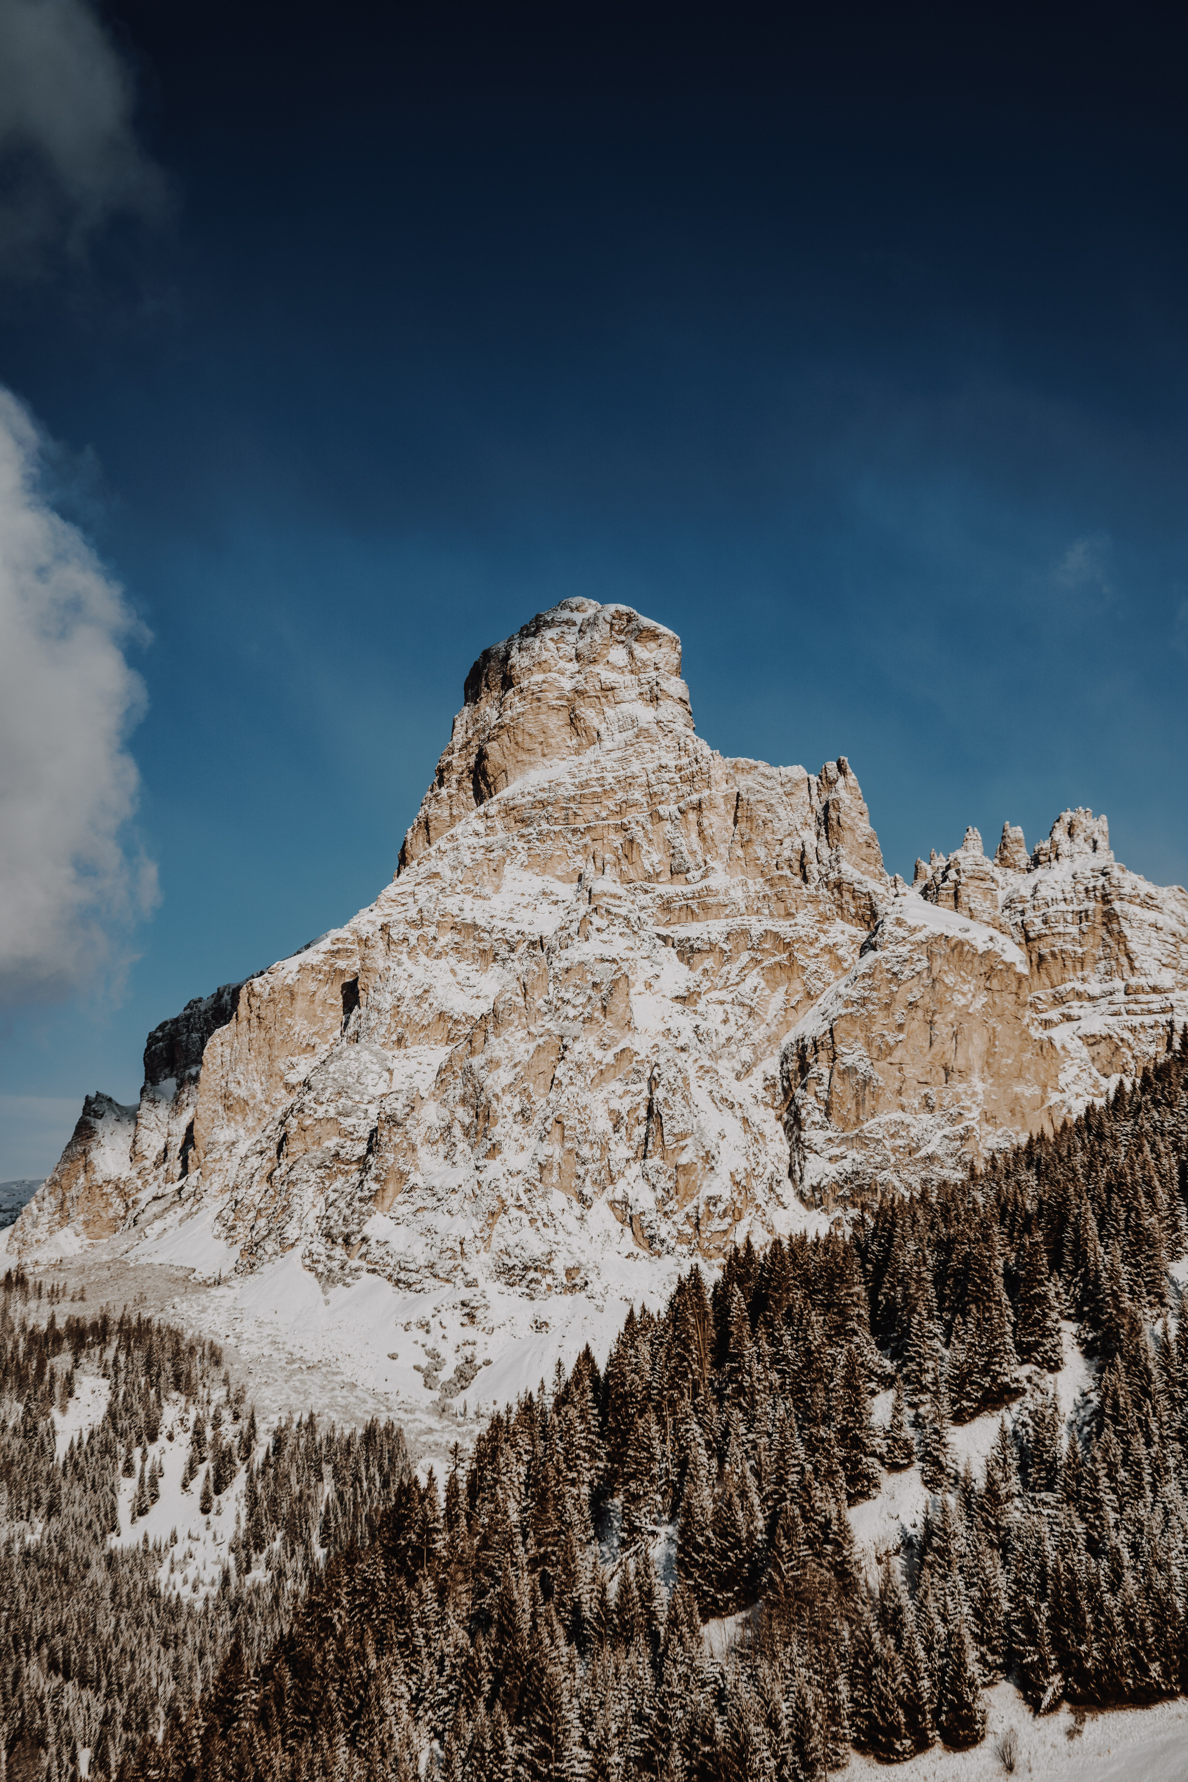
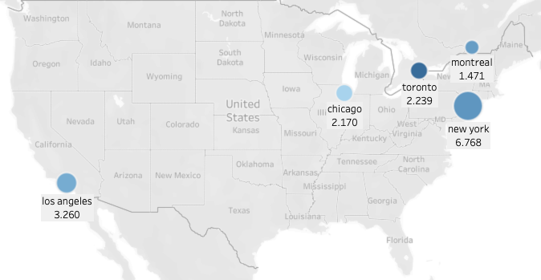
Where Our Users Reside
TravelTide brings together a lively community of travelers from the USA and Canada.
About 30% of the users in our study live in these five cities

Slide 7

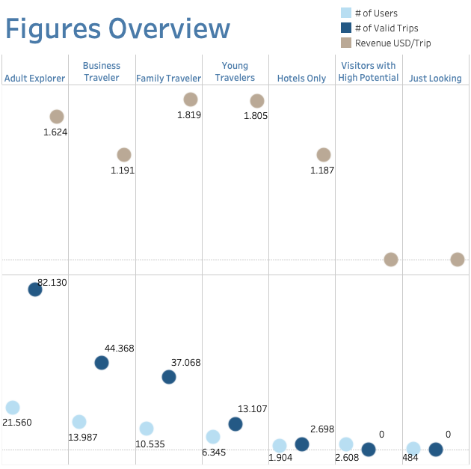
Cohort & Facts
We have extended the cohort duration from 6 months to 1 year to analyze user behavior across all 4 seasons.
TravelTide Launch
April 2021
28-JUL-22
28-JUL-23
Cohort
Period: 28-Jul-22 to 28-Jul-23
Focus: Users with > 7 sessions

Slide 8

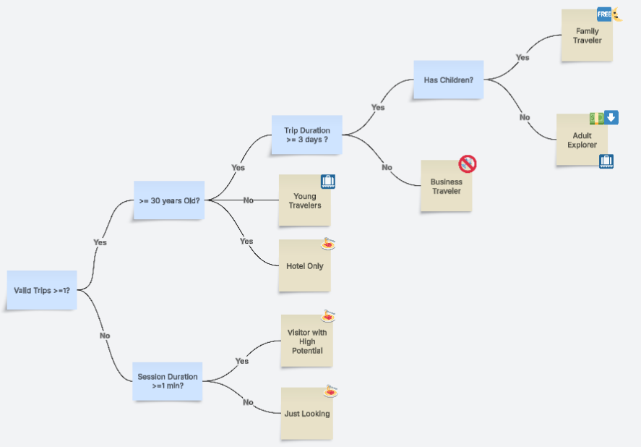
Decision Tree

Slide 9

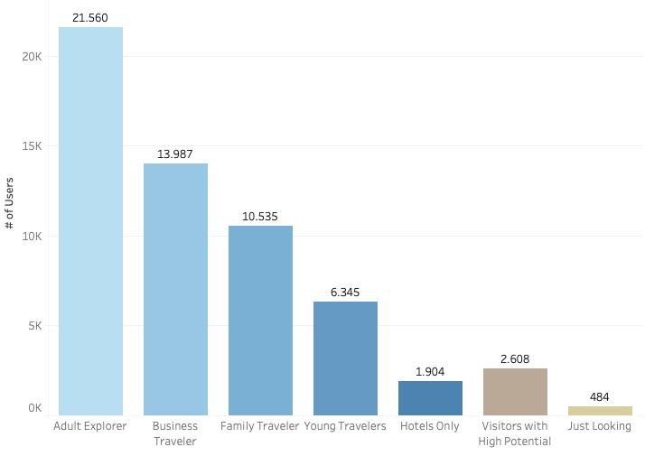
Grasping Customer Profiles Across Different Segments

Slide 10



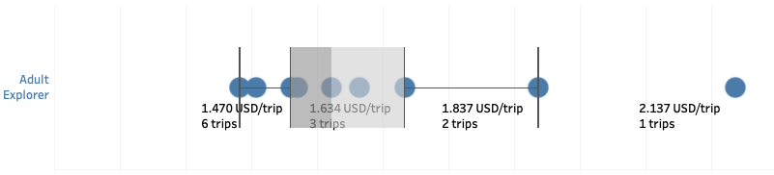

Adult Explorer
128.695 MUSD
1.624 USD/Trip
21.560
37,55 %
Alone or as a couple, this traveler enjoys quality experiences by exploring new cultures.
They still don’t have kids.
They savor local delicacies and unique adventures, often visiting art galleries, festivals, and scenic hikes. Each journey focuses on creating lasting memories rather than collecting souvenirs, whether it's enjoying wine at a vineyard or watching sunsets in beautiful landscapes.
Laura Müller
38 Years Old
Architect
Exclusive Discount
&
Free check Bag

Slide 11

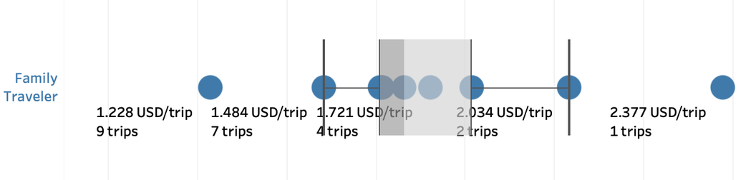
Family Traveler
64.652 MUSD
1.819 USD/Trip
10.535
18,35 %
Daniel Lopez (Father)
42 Years Old
IT Manager
Traveling with family involves choosing destinations suitable for both adults and kids.
Seek family-friendly resorts with amenities like children's clubs and kid-friendly menus, ideally located near beaches and theme parks for a mix of relaxation and adventure.
Opt for spacious accommodations for comfort and privacy, and look for deals that enhance the experience.
With proper planning, family travel can create cherished memories and quality time together.
One night free hotel with flight

Slide 12

Business Traveler
52.791 MUSD
1.191 USD/Trip
13.987
24,36 %
As a seasoned traveler, enjoys frequent short trips to familiar destinations, finding comfort in routine.
Each journey brings anticipation and joy, whether it’s a café in Paris or a beach in Florida.
The magic lies in revisiting places, meeting people, and creating memories, with each trip adding a chapter to your ongoing story of exploration and adventure.
Markus Weber
45 Years Old
Sales Executive
no cancellation fees

Slide 13
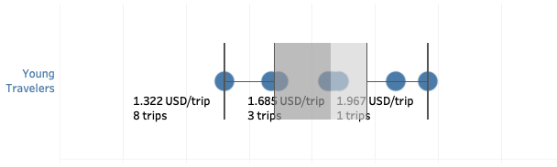

Young Travelers
18.356 MUSD
1.805 USD/Trip
6.345
11,05 %
An adventurous, budget-conscious traveler enjoys short trips to exciting destinations.
They specialize in weekend getaways, hiking, and spontaneous beach escapes while finding the best deals.
Their small suitcase contains essentials like comfortable shoes, a camera, and a journal.
With enthusiasm and curiosity, they explore the world, gathering enriching experiences and stories.
Diego Torres
24 Years Old
Digital Nomad
Free check bag

Slide 14
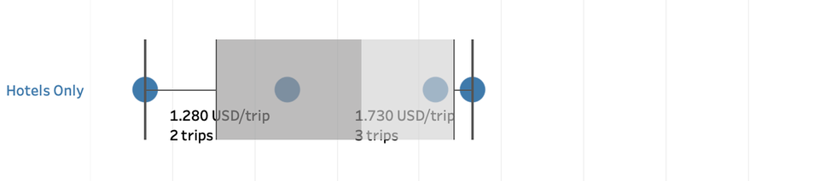

Hotels Only
676 MUSD
1.187 USD/Trip
1.904
3,32 %
Sophie Dubois
35 Years Old
Event Organizer
Books hotels but avoids flights, favoring road trips for the adventure.
This approach allows exploration of hidden gems, charming towns, and stunning landscapes.
Each journey becomes a unique story, enriched by spontaneous detours, local eateries, and memorable encounters.
Free hotel meal

Slide 15

- MUSD
- USD/Trip
Visitor with High Potential
Sessions lasting longer than one minute.
2.608
4,54 %
This web-page visitors are constantly researching and seeking the best deals and destinations for their trips, whether spontaneous or planned.
They gather insights and inspiration with each search, aiming to save money while discovering unique experiences.
When the right opportunity arises, they quickly act to make their travel dreams come true.
Eva Smith
31 Years Old
Marketing Analyst
Free hotel meal

Slide 16

Just Looking
- MUSD
- USD/Trip
484
0,84 %
Curious and independent users browse travel options without committing to a trip.
They spend little time on the website, showing browsing behavior rather than purchase intent.
Their exploration indicates potential interest, making them ideal for inspirational content, personalized recommendations, or time-limited perks to encourage their first booking.
Lucas Martin
26 Years Old
Graphic Designer
Free hotel meal
(after the first minute of the session)

Slide 17
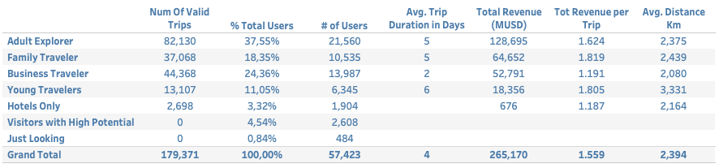
Summary & Next Steps
Next Steps
Conduct A/B testing, focusing primarily on the first three segments, to assess the effectiveness of the provided perks for these groups.
Evaluate the economic impact of implementing the suggested perks.
Develop loyalty programs that provide additional perks based on the frequency of engagement.

Slide 18
TravelTide
Thank You
Erick Strampfer Monje

